Slide 1
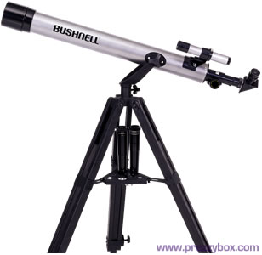
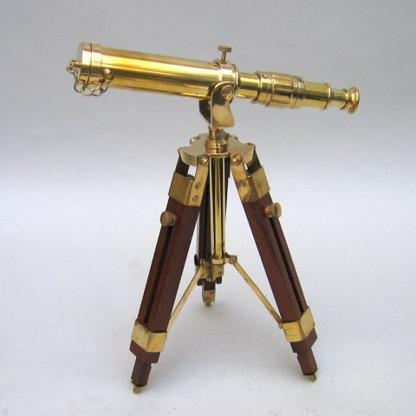
Astronomy Section 1
By Lauren Anderson

Slide 2
Ancient Calendars
Back about 5,000 years ago people used the seasonal cycle of the stars and planets to mark time. They built observitories and studied at night. Although the ancient civilazations didn´t fully understand the stars and planets there studying still led the first calenders.

Slide 3
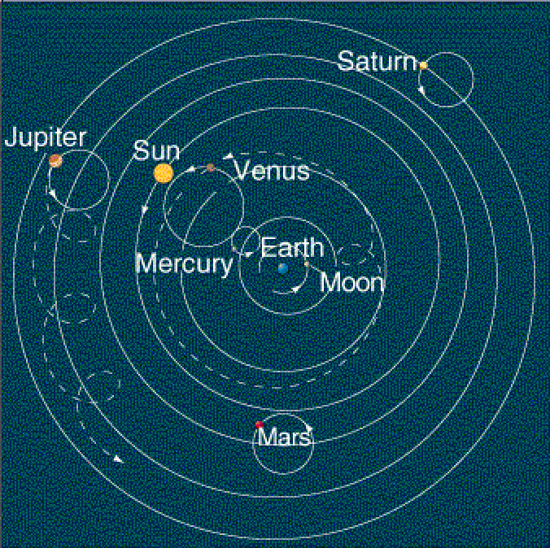
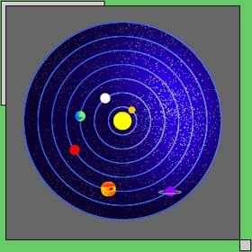
Early Astronomers
In 140 CE, Ptolemy, one of the earliest astronomers, belived that the Earth was in the center of all the planets including the sun. For over 1,500 years his theory was belived throughout Europe.
In 1543, Copernicus brought a new theory. According to his theory the sun was the center of the universe and the planets orbited it. Even though his theory was correct it did not replace Ptolemy´s theory.

Slide 4
The Beginning of More Understanding
Tycho Brahe used several advanced tools to make a theory that the Sun and the Moon revolved around the Earth. But the other planets orbited the Sun. Although his theory was not correct it provided other astronomers help.
Johannes, Tycho´s apprentice, did not believe in his teachers theory. After seeing the usefulness in his teachers data he came up with a new theory. He announced that all of the planets orbited the Sun.

Slide 5
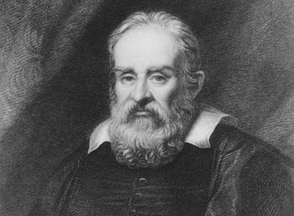
Galileo
In 1609, Galileo became one of the first people to create a telescope and use it. People found that the other planets were not just wandering stars but had physical bodies like Earth.

Slide 6
Modern Astronomy
Today when technology is becoming better we are making new discoveries in space. For example, we think we may have discovered more galaxies and are learning more about the planets in the Milky Way.

Slide 7
Astronomy | The study of the universe.
Year | The time required for the Earth to rotate around the Sun.
Month | The amount of time for the moon to rotate around the Earth.
Day | The amount of time it takes the Earth to rotate around its axis
Vocabulary

Slide 8
Telescopes Section 2
Types of telescopes include:
The Optical Telescope which collects visible light and focuses it to a focal point for closer observation.(These are the most common type of telescope)
Refracting telescopes use lenses to gather and focus light.(Most astronomers do not prefer refracting telescopes because the size of the view is limited by the size of the lenses)
Reflecting telescopes use a curved mirror to gather and focus light. (Most astronomers only use this type of telescope for gathering light and it is not that common)

Slide 9
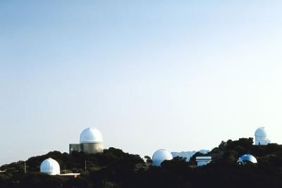
Working together
Two large reflecting telescopes work together. For example they each focus all of their mirrors on the same area.

Slide 10
The Electromagnetic Spectrum
For thousands of years people have been using their eyes to observe the planets and stars. But scientists have finally discovered visible light that we can see. Visible light is not only a form of radiation but is part of the electromagnetic spectrum. The electromagnetic spectrum is made up of all the wavelengths of electromagnetic radiation.

Slide 11
Detecting Electromagnetic Radiation
Each color of light is a different wavelength of electromagnetic radiation. For example, Humans can see radiation from red light, which has a long wavelength, to blue light, which has a shorter wavelength. But visible light is a very small part of the electromagnetic spectrum. The rest includes radio waves, microwaves, infrared light, ultraviolet light, x-rays, and gamma rays.

Slide 12
Radiation Telescopes
Radio Telescopes
Nonoptical Telescopes
Used to study radio waves. Most radio radiation reaches the ground and can be detected both during the day and night.
Used to study invisible radiation. Scientists use these telescopes to study radiation that cannot be seen by human eyes.

Slide 13
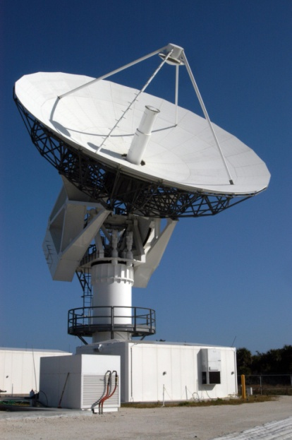
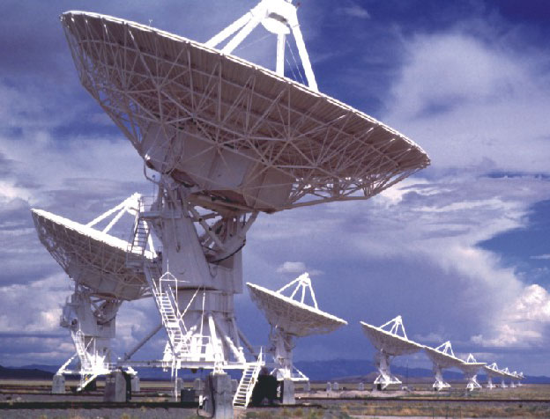
Linking Forces
Radio Telescopes
Astronomers can receive more detailed images of the universe by linking radio telescopes.

Slide 14
Vocabulary
Telescope | An instrument that collects electromagnetic radiation from objects in space.
Refracting Telescopes | A telescope that uses a set of lenses to gather and focus light from distant objects.
Reflecting Telescopes | A telescope that uses a curved mirror to gather and focus light from distant objects.
Electromagnetic Spectrum | Is made up of all the wavelengths of the electromagnetic radiation.

Slide 15
Mapping The Stars (Section 3)
Constellations are the patterns that you notice in the sky. They help to organize the sky because you have one constellation for each place. Also different types of constellations appear on different days. That is how people in the olden days could tell the time and make calendars.

Slide 16
Stars Paths
As the sun appears and moves over the sky during the day, most stars and planets rise and set throughout the night. This movement is caused by Earth´s rotation. As Earth spins on its axis, stars and planets appear to move. Near the poles stars are Circumpolar, which means they are seen all year and all night.

Slide 17
Distance in Space
Objects that are very far away do not seem to be moving at all on Earth and in space. Stars are much further away than the planets are to Earth. In fact stars are light years away from Earth and the other planets. The furthest objects we can observe are 10 billon light years away.

Slide 18
An Expanding Universe
After discovering that the universe is made up of many other galaxies like our own, we have started to discover other moving things and other nearby galaxies.
The End

